Slide 1
Be the change you want to see
Annual Mid Term & Impact Report 2022
Say hello@sharecouncil.co
or call with us +31 (0)20 244 0608

Slide 2
" The world's biggest problems
are just getting bigger
While the world's richest
are just getting richer "
Ton Dobbe - January 2022
We're fixing exactly this!
Where the capital wealth gap currently still is heavily rising, we have managed to slowly but undoubtedly redistribute some of it by creating ownership opportunities. Share Council is proud of the slow but steady growth towards a more equally spread society. A society in which we live together instead of just amongst each other. A society where capital is a tool for all instead of a goal for a few.
Quintus Willemse - August 2022

Slide 3
Management Summary
TL;DR
€ 343 million in assets redistributed
2.393 employees became co-owner
New legislation for Options got passed
The first 6 months of 2022 and main projects to come
We have launched a completely new website: sharecouncil.co
We have launched a constantly expanding Share Academy
We've been working on employee participation courses
We have surpassed last years revenue of EUR 199k
Monthly Recurring Revenue of over EUR 10k (magic milestone), now an MRR of EUR 11.4k
We did feel the seasonal downturn in the summer where only a few clients per month signed up
We do already feel the tailwind of the end of the summer where one after the other signs their proposals
Proud that the first months of the year showed an operational profit
Our model seems to work, we are already administering EUR 343 million in assets held by employees (redistributing capital wealth)
We are very proud to have reached almost 80 clients
Equally proud of clients like bunq, MyWheels, mijndomein, ACE
Very proud of ACE just launching their ACE coin and working with us to distribute ownership through the blockchain model and API
In september we are starting the "137 mio participants club"
We have launched the Share Support Foundation
Proud to communicate we have a verbal agreement on new investments of EUR 525k and counting
In september we will start our new share emission on Nxchange
We do still need investment to have the cash liquidity for growth

Slide 4
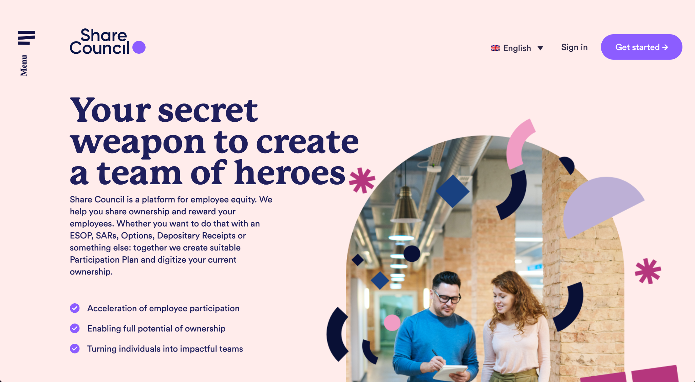
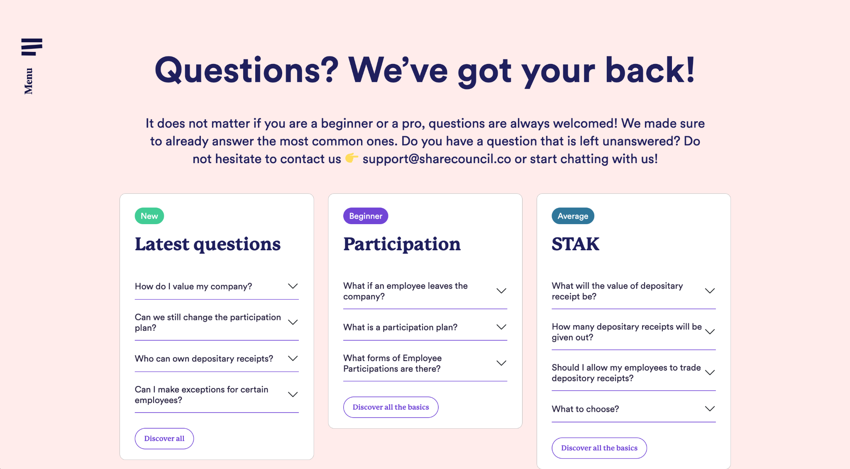
New website
Dutch & English + Share Academy +
Share Courses

Slide 5
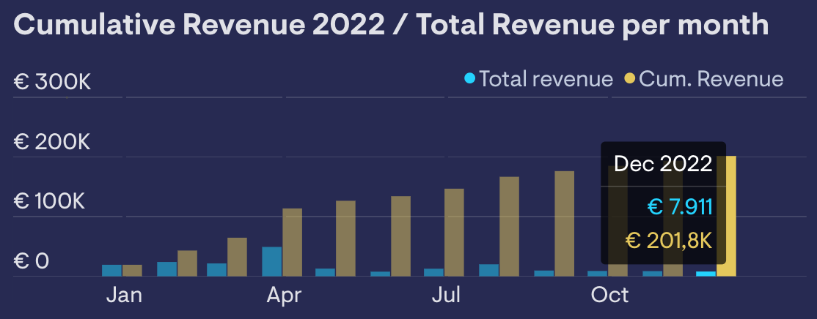
Financials
Turnover EUR 200k +
Signed and invoiced amounts
Halfway the year we have surpassed the total revenue of last year, being EUR 199k
Key investment financials
Monthly Recurring Revenue up 1k
Customer Acquisition Costs down 1k
Customer Lifetime Value up 3k
MRR
€ 11.4k
CAC
€ 3.5k
CLV
€ 17.7k

Slide 6
Financials
Seasonal influx
Client and cash influx
We notice every year a downturn just before the summer, and a recovery
1
2
3
4
5
6
7
8
9
10
11
12
Profit
Operational versus actual profit
30k
20k
10k
0
1
2
3
4
5
6
7
8
9
10
11
12

Slide 7
Financials
Balance sheet
ASSETS
Intangible assets
Financial fixed assets
Current receivables
Liquid assets
Assets
mid '22
€ 166,157.14
€ 10,564.92
- € 104,945.81
€ 4,840.98
€ 77,217.23
start '22
€ 166,157.14
€ 10,564.92
- € 68,825.74
€ 146.84
€ 108,643.16
LIABILITIES
Equity
Services
Long-term debt
Current liabilities
Liabilities
mid '22
- € 355,865.39
- € 24,924.00
- € 55,087.00
- € 149,772.86
- € 585,649.25
start '22
- € 350,308.39
- € 24,924.00
- € 55,087.00
- € 122,482.11 - € 552,801.50
RESULT
Result (To process)
Result (Selected year / Period)
Result
mid '22
- € 444,158.34
- € 64,273.68 - € 508,432.02
start '22
- € 444,158.34
- € 444,158.34
BALANCE
Balance total
mid '22
€ 0.00
start '22
€ 0.00

Slide 8
Financials
Profit & Loss
Revenue
Total Revenue
mid '22
€ 132,311.59
signed '22
€ 201,800.00
Labor Costs
Salary costs
Other personnel costs
Total Labor Costs
mid '22
€ 58,493.17
€ 1,017.10
€ 59,510.27
Other Costs
Personnel costs
Housing costs
Sales costs
Office costs
General costs
Financial income and expenses
Total General Costs
mid '22
€ 18,664.42
€ 11,700.00
€ 16,751.73
€ 9,999.38
€ 79,628.14
€ 331.33
€ 137,075.00
Result
Total Result
mid '22
- € 64,273.68
signed '22
€ 5,214.73

Slide 9
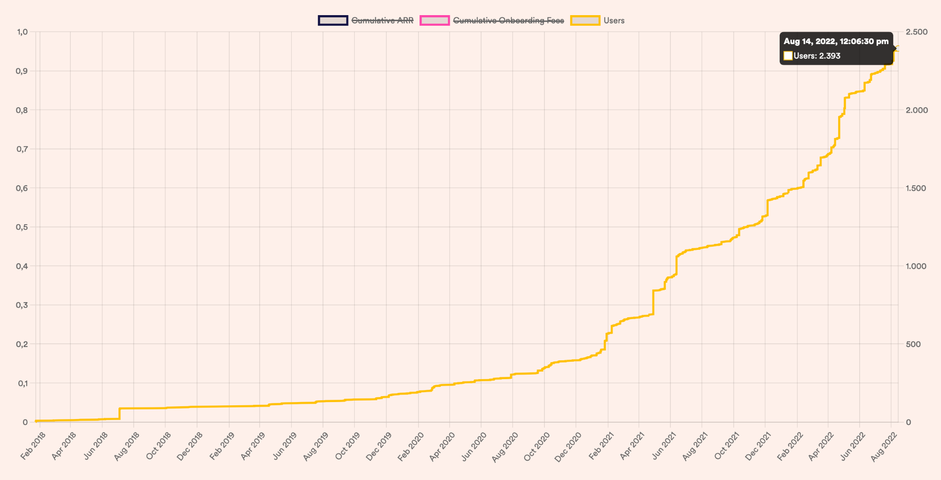
Impact KPI's
Capital redistribution using our capitalistic system
We've seen a quick increase on our user base now on 2.3k individual true participants owning companies and 3.8k "sold seats". We already administer EUR 343 million in assets for this group.
€ 343 million in assets
2.393 employees
Impact companies help us change our world
We have a focus on impact companies because of the catalyzer effect of helping each other out to change the world for the better.
78 companies
36 impact companies
of which

Slide 10
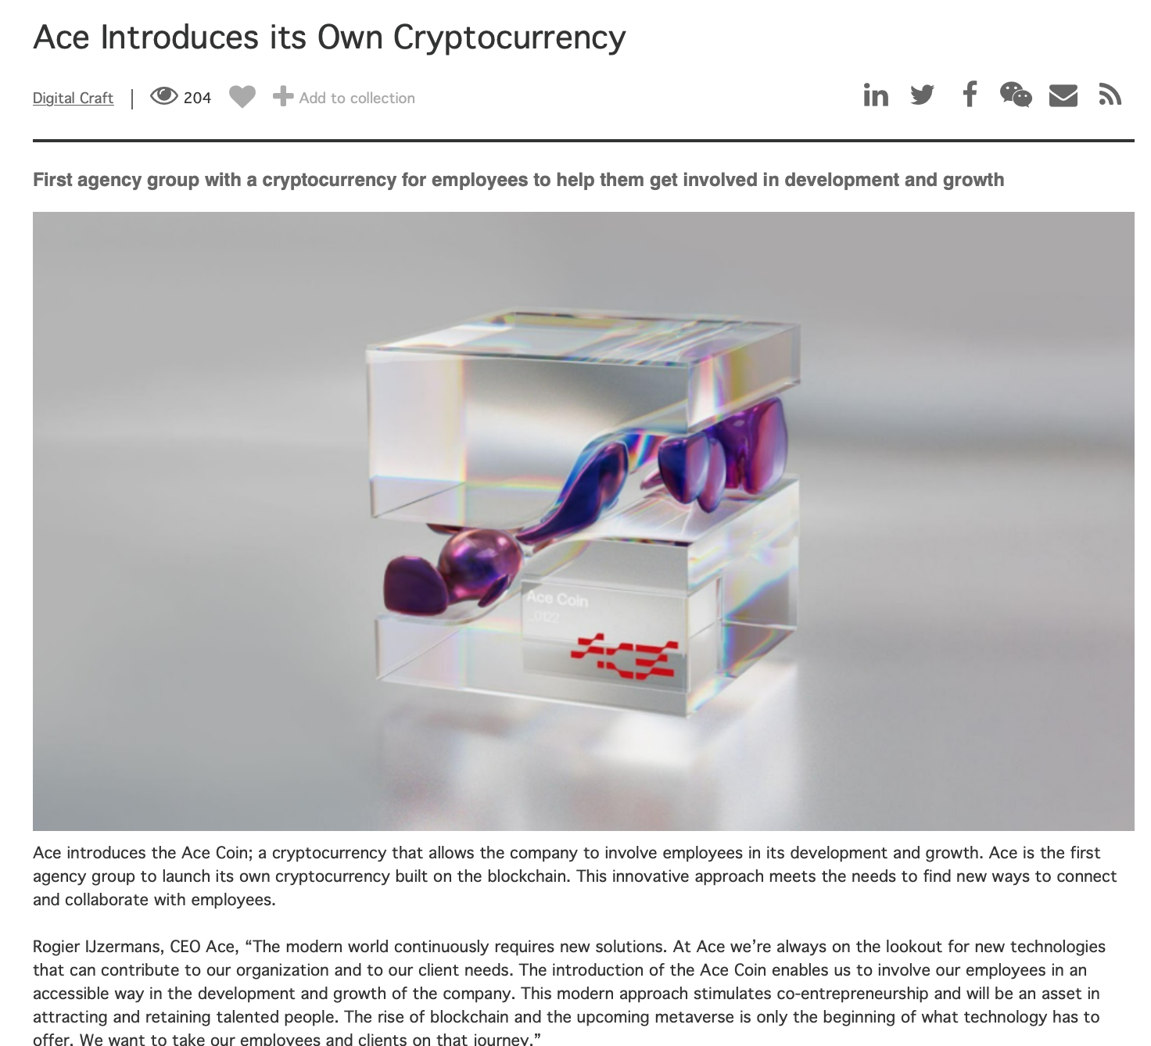
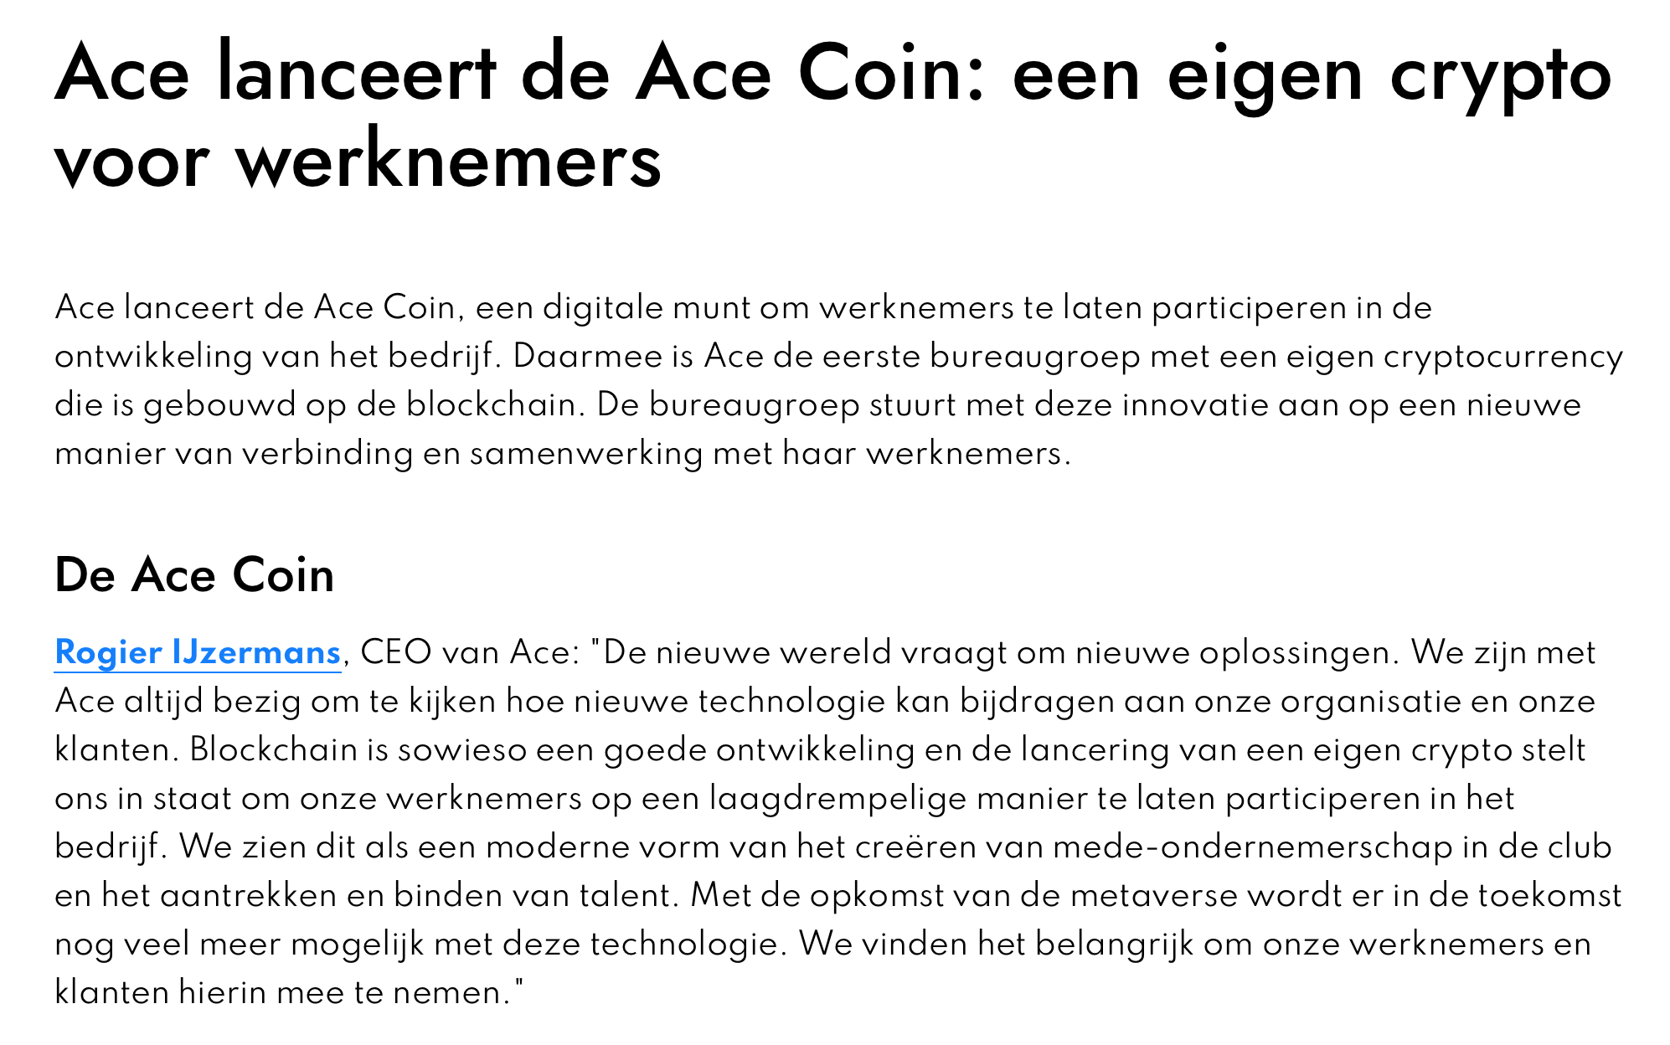
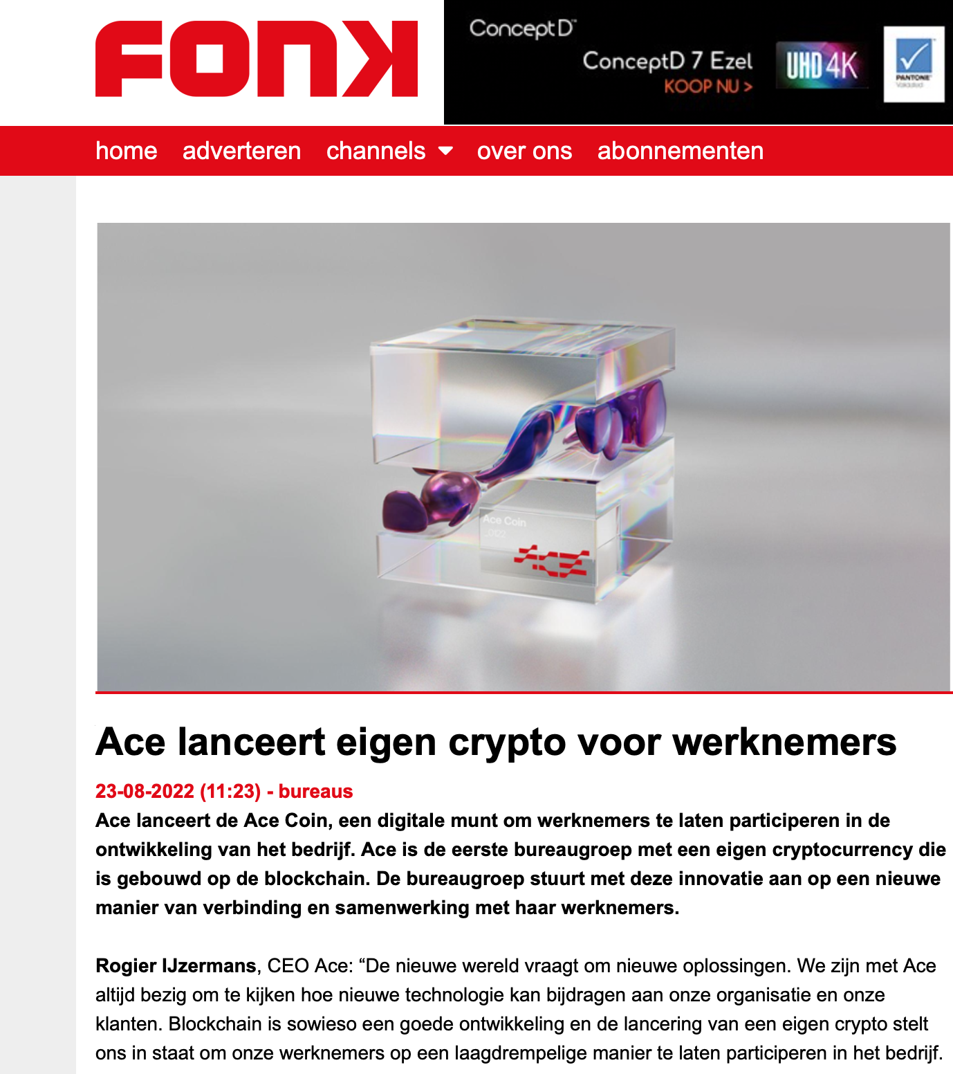
ACE coin
API development
Our new customer ACE (thisisace.nl) just launched their own coin. This is big news for us, because Share Council is used to give employees a change to go one step further with the coin, become co-owner. And all of this based on blockchain technology.
Share Council API
Ace has developed their own internal phone app and will be one of the first to integrate our API in their platform. In the coming months you will see more development around our API and integration opportunities.

Slide 11
137 million
participants club
Share Council is committed to making 137 million employees in Europe co-owner of the company they work for.
Why 137 million? Because that's how many people are working for all European SME's together and it's the one single biggest group of individuals.
Why SME's? Because they account for the biggest part of the European economy.
We have selected a team of incredibly strong companies who are willing to support us in making this happen.
We have set up a community website which will be launched in September.
We are measuring this as our single most important goal.

Slide 12
The Share Support
Foundation
Supporting employees co-owning the company they work for
The Share Support Foundation financially supports employees who have the possibility to become co-owner of the company they work for but do not have the means to acquire the shares.
With good intentions more employers give employees the chance to participate. But we too often see that only the top and middle management has the funds to go along. The Share Support Foundation is there to secure that every layer of the company can participate.
Read more in our publication → link

Slide 13
Investment round
EUR 1.5 mio
We are raising funds to be able to achieve our mission with a stable foundation
137 million SME employees in Europe, co-owning the company they work for
EUR 525k
The investment round of max EUR 1.5 mio will assure a stable growth and expansion of the company. At the moment we have verbal agreements on EUR 525k which will play out in the month september.
New emission on Nxchange
In september we will also finally start the emission of new certificates as agreed against a EUR 0,30 per piece valuation.
We will release this in batches for as much is needed to support our growth and stability. This means that we will start with the first 550 and close new funding rounds consecutively in month to follow.

Slide 14
Thank you for supporting our mission
When little wonders are actually recognised, big wonders start to occur…

